Slide 1
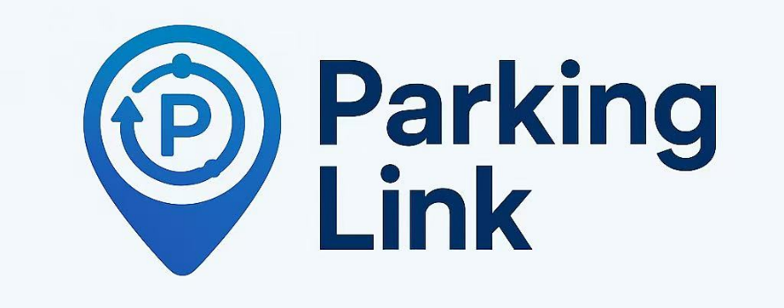
Parking Link
Intelligent-Matching Shared Parking Space Application
Nov. 3rd, 2025
Group Members: Ren Kai, Jiang Yiming, Lan Yang, Hou Jinyi, Hu Rui

Slide 2
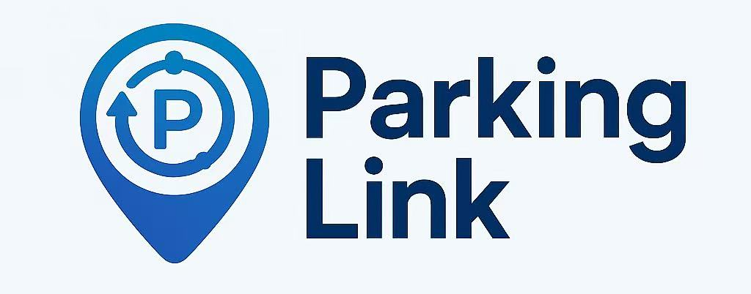
Contents
Application Purpose
Problem and Solution
Market and Competitive Analysis
Business and Revenue Model
Business Plan and Goals

Slide 3



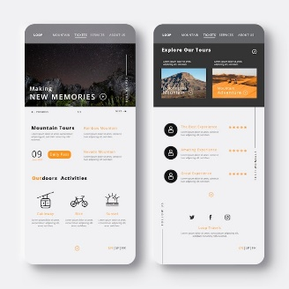







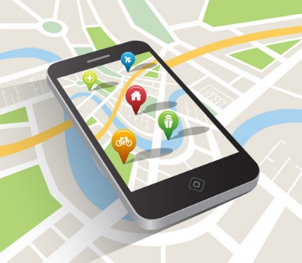













1. Application Purpose
Resource Identification
Resource Allocation
Private
Public
Unknown
Search
Reservation
Start Time
End Time
Location
Plate No.
Closer
Certification
Approval
Cheaper
More Flexible
Pool of Parking Space
Users
Community System
Community
Approval
Radar
Monitor
Staff
(main)
(sparse )
(dense)
Navigation
Payment
Pool of Parking Space Available
Payment Binding
Margin Deposit
Permission
Dynamic Pricing
Vacancy Rate
Forecast
Space Recommendation
Resource Allocation Strategy
AI
User Info
Time
Location
History
…
Weather
User Habits
Price
Distance
FIFS
User Points
Subscription

Slide 4
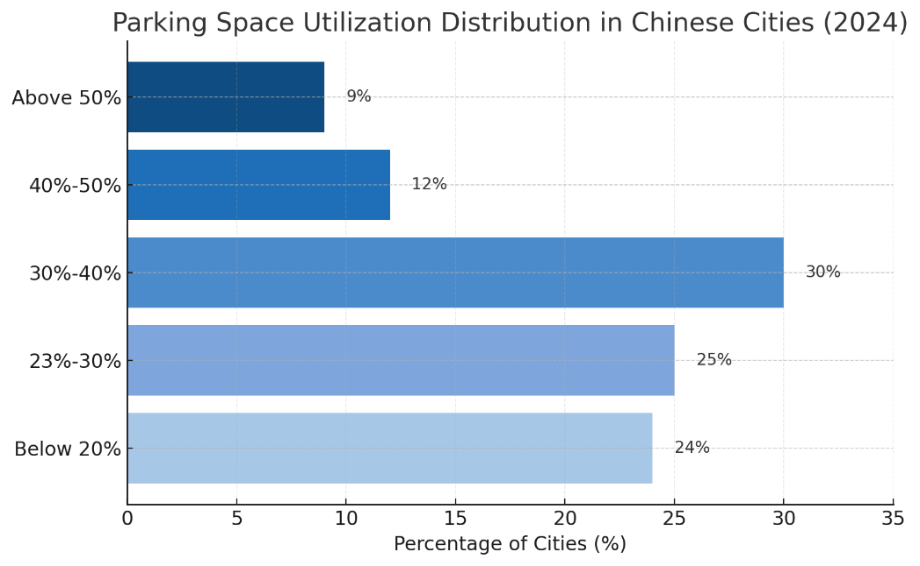
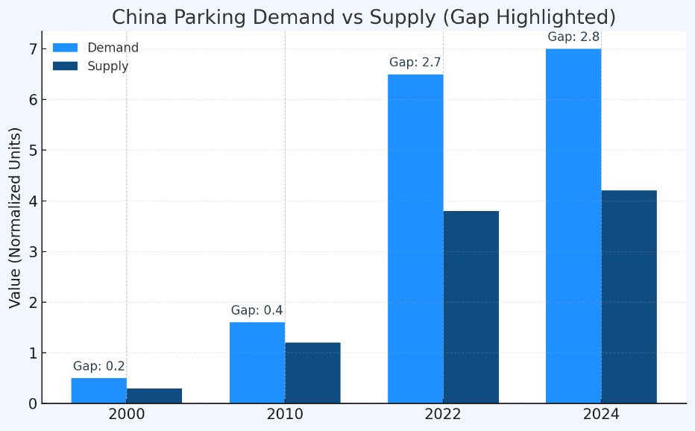
2.1 Problem Definition
The Urban Parking Challenge:
Absence of parking resources ? The failure of Resource Identification and Allocation ✓
340M+
Large Vehicle Scale
Low Plan Delivery Rate
9%
Low Utilization
No Unified Platform
897K
Resource Idle
No Dynamic Prediction
Lack of Real Time Data
High Research Cost
Data Source: Ministry of Public Security of China
High Idle Rate
High Congestion
Paradox
Fig 1. Parking space utilization distribution in China (2024).
Fig 2. China parking demand vs supply.

Slide 5


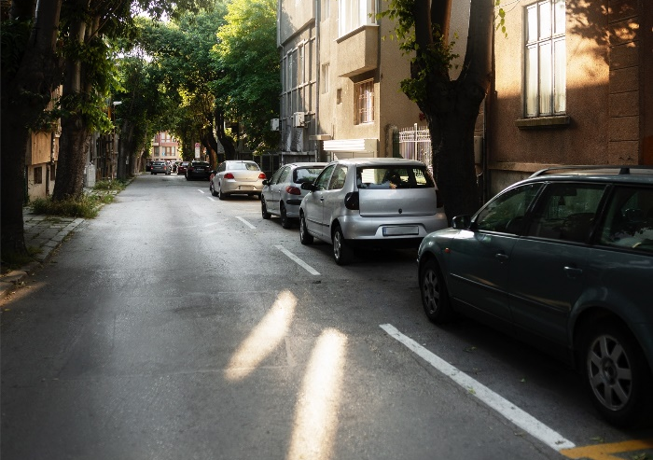




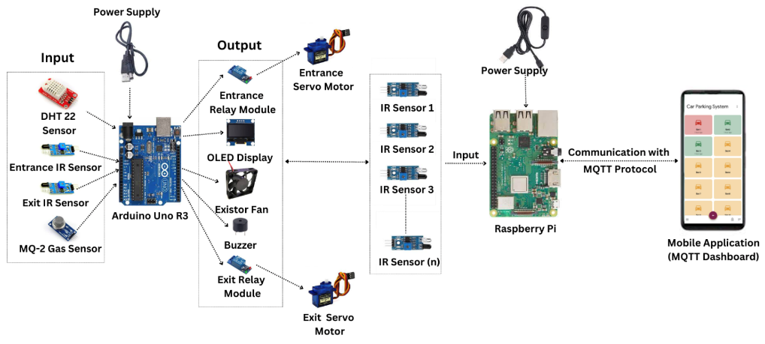


2.2 Current Solutions and Shortcoming
Traditional
Parking Lots
Mobile Parking
Apps
Independent, Manual operation
Limits
❌ Real-time data
❌ Dynamic price
❌ Unified management
Map-based search, payment
Limits
❌ Timely updates
❌ Access to private lots
Smart Hardware (IoT Systems)
Summary of
Current Solutions
Local automation
Limits
❌ Affordable & Scalable
❌ Shared Data
❌ Cross-system integration
Location
Availability
Access Permission
Scheduling
Data Integration

Slide 6











2.3 Proposed Solution
Resource Identification
Resource Allocation
Resource Registration and Identification
Dynamic Pricing Algorithm
Private Space
Public Space
Unknown Space
User Information
Time Period
Current Price
Location
Certification
Approval
Refusal
Historical Price
Multimodal Recognition on Idle Spaces
Multiple Resource Allocation Modes
Community System: Vehicle Entry and Exit
Discount
Long Term Lease out
Long Term Lease in
Priority
User Points
Subscription
Radar Detection: Areas with Sparse Parking Spaces
Basis
First In First Serve
Monitor Detection: Areas with Dense Parking Spaces
Get points by transactions or subscribe to the service to enjoy high priority (discounts, order priority processing, more recommended spaces)
Long term parking space leasing brings lower costs and higher profits
Staff Screening: Manual Identification of Idle Spaces

Slide 7





3.1 Market Assessment
Shenzhen
4.5M
>>
2.5M
Huge Gap Suggested parking space ratio is 1:1.1
Beijing
5.6M
>>
4.3M
yet a 1M shortage due to uneven distribution
<
6.5M
Shanghai
5.8M
​​Millions-strong demand for parking in large cities result from overall scarcity and uneven spatial distribution.​
China’s shared parking market is forecast to expand at a 15.8% CAGR, rising from an estimated RMB 350 billion in 2025 to RMB 1.2 trillion in 2030.
Data Source: Traffic Management Authority, Official News, Shared Parking Research Report

Slide 8












3.2 Customer Needs
Who Need
Why Need
How Meet
Financial Return​
Turn Idle Time into Income​
Personal Parking Space Owner
​​Easy & Secure Operation​​
​​Full Control, Built-in Safety​
Instant Access
​​Find Your Spot
Before You Arrive
Drivers
Seeking Parking​
Lower Cost
Enjoy Exclusive Neighborhood Discounts​
Optimize Resource Utilization
Turn Idle Space into Income​
Commercial Property Managers​
Improve Local Traffic Conditions​
​​More Parking,
Less Congestion
​​Solve Parking Shortage​
​​Validated Answer to
Urban Congestion
Goverment
​​Smarter Traffic, Cleaner City
​​Fewer Empty Miles,
Cleaner Air​

Slide 9




3.3 Competition and Alternatives
Intensity of
Competitive Rivalry
Threat of
New Entrants
Poter’s Five Forces
Degree: Low
​​Number of competitors: No dominant player
Volume of buyers: Large
Market growth: Fast
Buyers’ switching cost: Low
Degree: Medium
Market attractiveness: Profitable market
Entry barriers:
Low switching cost
Strong economies of scale
Threat of
Substitute
Degree: Low
Relative quantity of substitutes: Large but less convenient
Relative price of substitutes: Higher
Buyer switching cost:Low
Bargaining Power
of Suppliers
Bargaining Power
of Buyers
Degree: High
Suppliers concentration: Medium
Cost of switching supplier: High
Substitute inputs: Few
Degree: Low
Buyers switching cost: Low
Buyers concentration: Low
Buyers volume: Large

Slide 10


3.3 Competition and Alternatives
VRIO Framework
Valuable
Nearby Parking
Lower Prices
Efficient Matching
Local Support
Rare
Limited Community Resources
Locally-Sourced Data
Difficult to Imitate
Difficult to Re-negotiate
Data Requires Long-Term Accumulation
Supported by Organization
Professional Corporate Team
Local Operations Team
Sustained Competitive Advantage

Slide 11

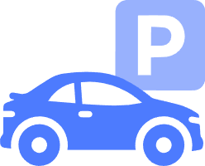


4.1 Business Model
Park Link uses AI technology as its core driving force to build a tripartite connected ecosystem of "parking supply side platform parking demand side", focusing on the two core pain points of "difficult resource identification" and "chaotic resource allocation" in the parking space field, and creating differentiated value for different participants:
Supply Side
Demand Side
Private Space Owners
👤 Individual Users
Monetize idle time slots
Zero operational cost
Save search time
Parking cost down
Dynamic pricing profit share
availability accuracy&Member priority access
Parking Link
AI Smart Matching | Dynamic Pricing
Credit System | Payment Settlement
Properties/Communities
🏢 Enterprise Clients
Utilization up
Smart parking upgrade
Reduce fixed cost
Flexible quota management
Public parking management
Employee parking outsourcing
Enterprises/Parks
VIP Users
Bulk long-term rental
Activate idle assets
Advance booking lock-in
Priority dispatch rights
Flexible resource allocation
10-20% member discount

Slide 12




4.2 Revenue Mode
Price
View pricing for personal, business, and enterprise packages.
Normal Version
Premium Version
Enterprises Version
Target Audience: General users, newly registered users, individual identities
Object: Sticky Users ￥88month, ￥680/year
Enterprise level AI, security, and large-scale support
FREE
7 days free to use
Quick Parking Spot Search
New Member Discount
Coupon
Price discount
Priority Booking Rights
No Margin Requirement
Priority Customer Service
Quick Parking Spot Search
New Member Discount
Coupon
Price discount
Priority Booking Rights
No Margin Requirement
Priority Customer Service
Customized services
Batch production
Customized program references
Source of stable parking vehicles
Invoicing and billing, bulk discounts
Purpose: To quickly obtain and
form network effects
Purpose: To increase stickiness
and revenue
Purpose: To stabilize cash flow
￥ 10-20 / per hour
￥ 9-18 / per hour
Depending on the size
of the company
Our commission: 10-20%
10% discount, parking time only needs to
exceed 60 hours per month
Individual service
Individual service fee

Slide 13





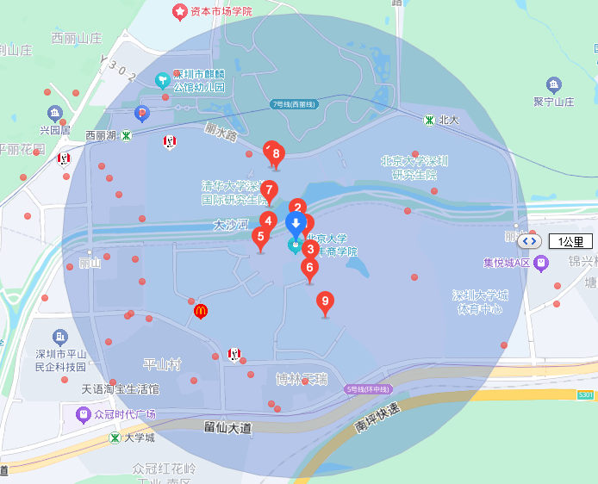

4.2 Revenue Mode
Dynamic pricing calculation process
Pricing dimension | weight
User historical bid | 15%
Real time supply and demand | 25%
Weather impact | 5%
Surrounding activities | 10%
Competitor price | 10%
User points | 8%
Membership level | 12%
Distance attenuation | 10%
Time prediction | 5%
…… | ……
Ex
Base price
Regional coefficient
Time period coefficient
User Discount
￥10
1.5 Times
1.2 Times
0.9 Times
Final Price：10 × 1.5 × 1.1 × 0.9 = 16.2
welcome, dear VIP users
your pos: PHBS
PHBS Parking Lot
Details destination PHBS is good
Dis: 1.2 km
￥ 18 16.2
PKU Parking Lot
Details destination PKU is good
Dis: 2.2 km
￥ 20 18
Garbage Parking Lot
Due to various coefficients and algorithms, we guarantee that the price is cost-effective, and to some extent, it is much cheaper than parking spaces of the same quality
Details destination Garbage is good
Dis: 4.8 km
￥ 12 10.8

Slide 14
4.2 Revenue Mode
Monthly Park Link Revenue Estimation in Shenzhen: Use Up Estimation
business proportion
Average platform commission
Shenzhen parking spaces[1]
market share
Average monthly usage time
333 × 35% × 10% × 60% × 120 × 15 × 15% = 1888.11
The average idle rate (shareable potential) is about 30% -40%
average price
Type of income | Monthly income | Proportion | Gross profit margin
trading commission | 1888.11 | 48.45% | 55%
Subscription Members | 1418.58 | 36.4% | 95%
Enterprise Services | 345 | 8.85% | 78%
value-added service | 245 | 6.29% | 70%
total | 3896.69 | 100% | 65%
[1]From：https://finance.sina.com.cn/jjxw/2024-10-14/doc-incsnkcf2328831.shtml
The Five Pillars of Sustainability
Diversified income structure
2
3
4
5
1
Decreasing marginal cost
High net profit margin
Healthy
cash flow
Scalable

Slide 15
4.3 Unique Selling Points
Core Selling Point | Specific Performance | Difference from Competitors
AI-driven Multi-modal Accurate Parking Space Identification | Integrates four methods: monitoring network, cameras, radars, and staff patrols, covering areas with different management levels and parking space densities in a hierarchical manner. | Most competitors adopt a single identification method with an accuracy rate of around 85% and no property rights certification mechanism.
Personalized Intelligent Parking Space Recommendation & Full-process Closed-loop Service | Recommends parking spaces based on users' historical behavior, location, and price preferences, which is more in line with needs than the traditional "proximity recommendation".The reservation success rate reaches 95%, and the average time for finding a parking space is reduced from 30 minutes to 5 minutes. | Most competitors only recommend based on proximity and have fragmented processes that require jumping to navigation APPs.
Enterprise-specific Bulk Rental Solution | Provides customized solutions for enterprises' long-term/bulk parking space supply and demand needs. On the supply side, it helps enterprises quickly rent out idle parking spaces to recover funds; on the demand side, it solves the parking problems of employees or customers for enterprises and also provides traffic preferences. | Most competitors focus on individual users and have no enterprise-specific customized services.
Dual Rights System of Points & Subscription & Default Handling | Points can be redeemed for parking coupons and priority reservation rights; subscribed users enjoy discounts and free cancellation times. Violations will result in deduction of points and levels, controlling the user violation rate within 3%. | Most competitors only have a single points system without subscription rights and weak violation constraints.
AI Dynamic Pricing for Supply and Demand Balance | The AI system adjusts prices in real time based on factors such as user information, time periods, and competitors' pricing. It enables suppliers to obtain higher income during peak hours and attracts users with low prices during off-peak hours to avoid parking space idleness. For example, parking spaces around office buildings have a 30% premium during workdays and a 20% price reduction at night, increasing the parking space utilization rate to 80%, much higher than the industry average of 50%. | Most competitors adopt fixed pricing and have no premium sharing mechanism.

Slide 16




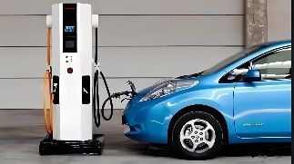

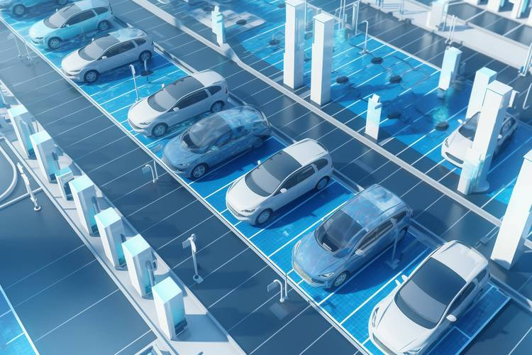
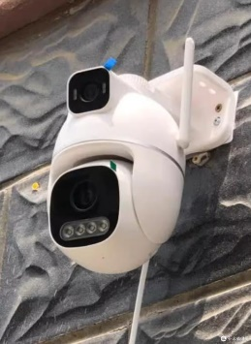
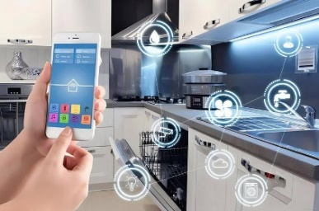
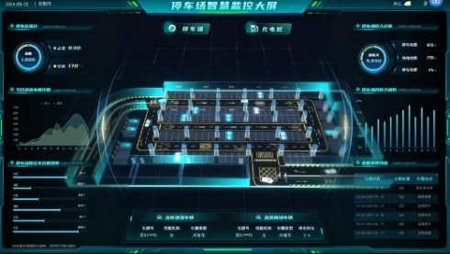
4.4 Scalability and Viability
Regional expansion
Business Extension
Data service
Government：Urban Static Traffic Report
Retailers：business district
customer flow analysis
Advertising Revenue
The third circle layer
The second
circle layer
The first circle layer
Next stage
International？
Car washing
Charging
Maintenance
Technological iteration and collaboration
4
3
Hardware
The entire process
1
2
System
AI technology
Notes:
持续投入 AI 技术研发，提升车位识别速度与动态定价精准度。与硬件厂商合作定制低成本、高性价比的摄像头与雷达设备，降低设备铺设成本。此外，接入新能源汽车充电服务商，在车位上增设充电桩，推出 “停车 + 充电” 套餐，适配新能源汽车市场需求。
Scalability and Viability: Address how your business can scale and remain financially
viable over time.
如何进一步规模化

Slide 17





5.1 Short-Term Goals
App Development
Within 3 months: Complete core functionality development for the app, achieving matching accu-racy rate of ≥ 55%, payment success rate of ≥ 90%.
Within 6 months: Deploy hardware in 3 parking zones within Nanshan District, Shenzhen (200+ parking spaces, status data collection accuracy ≥95%)
Within 9 months: Integrated hardware and app data to enable real-time parking space status.
Users and Market
Within 9 months: 4,000+ registered drivers, and 400+ parking space providers.
Within 10 months: Expansion to 3 districts, Futian District and Luo Hu District.
Within 12 months: Monthly matched orders ≥ 500. Weekly active users ratio ≥ 15%. Achieve monthly transaction volume ≥ RMB 80,000 to validate commercial viability.
Subsidies and Incentives
Streamlined Processes
Building Trust
First Order Free
Referral Cashback
Targeted ADs
Parking Space Providers
Network Effects
Rapidly accumulate users
Parking Space Users

Slide 18
5.2 Long-Term Goals
1 to 2 Years
Shenzhen Deepening Period
Within 3 Years
Expansion Phase
Within 5 Years
National Expansion Phase
Expanding into major cities in the Greater Bay Area such as Guangzhou and Dongguan, Establishing a “cross-city parking network,” achieving over 30,000 parking spaces per city and a total user base exceeding 3M.
Replicate the Nanshan model across all 10 districts of Shenzhen, achieving over 100,000 parking spaces and serving over 500,000 vehicle owners.
Expand into first-tier cities like Beijing and Shanghai, achieving nationwide parking supply exceeding 0.5M spaces and over 10 million users.
Market Expansion
Angel Round
Building Shenzhen's Parking Business Card!
A Round
Dominating the Bay Area Market.
B Round
Become China's No. 1 Smart Parking Application.
1. Intelligent matching algorithm accuracy: 85%.
2. Parking space radar hardware covers 80% of parking spaces.
3. User behavior database established.
1. AI Parking Space Prediction System.
2. AI Vision Hardware Replaces Radar, Reducing Costs by 30%.
3. Integration with Automakers' “Navigation-Parking” Module.
1. Smart Transportation Data Integration New B2B Data Services
2. Building the “Parking + Charging + Car Wash” Ecosystem
Technical Barriers

Slide 19



5.3 Execution Plan
Product Development
Algorithm Iteration: Quarterly optimization of matching abilities.
Hardware: Phased cost reduction + expanded coverage
Data System: Full-link data closed-loop
Marketing Promotion
Cold Start: Focus on local network effects.
User Fission: Incentivize growth on both supply and demand sides
Cross-City Expansion: Leverage regional synergies
Target Users
B2B: Securing supply and increasing Revenue.
B2C: Contextual outreach, offering parking vouchers, consumption packages.
Operations Monitoring
Goal Breakdown: Define core metrics by phase.
Iterative Optimization: Data-driven adjustments.

Slide 20
Parking Space Link, Resources Sync!
Nov. 3rd, 2025
Group Members: Ren Kai, Jiang Yiming, Lan Yang, Hou Jinyi, Hu Rui

